Slide 1
Building a Data Driven Library
Robbie McGregor
Library Programme Manager, University of Southampton
Rick Wilson-Rose
Customer Services Manager, University of Southampton
28 November 2025

Slide 2
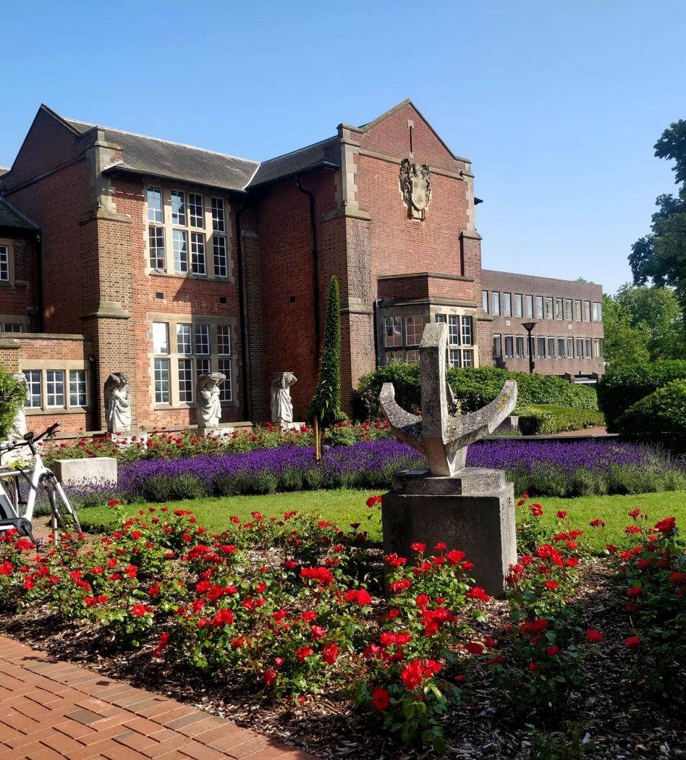
What We’ll Cover…
Why we started the project
The strategic benefits of the project
Our approach to delivering the project
Alignment with institutional strategies
Examples of how our data is making an impact
  Hartley Library Transformation
  Enquiries Process Transformation
  Collections Development & Discovery
  CSE Accreditation
  Local Impact – Customer Satisfaction

Slide 3
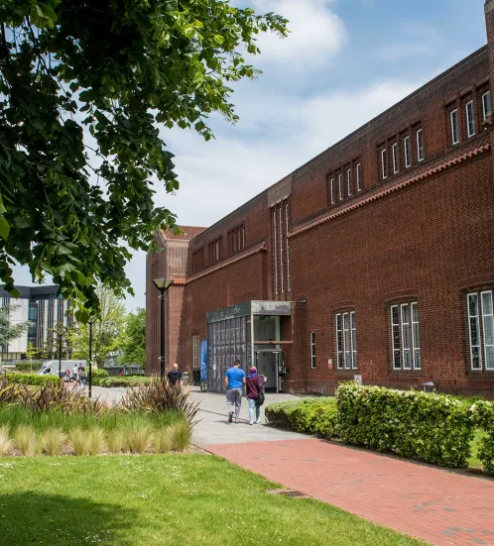
Why We Started This Journey
Fragmented Data Environment
  Data was siloed across teams, causing limited visibility and hindering data informed decisions.
Centralised Data Access
  The project aimed to consolidate data into a central dashboard to enhance accessibility and collaboration.
More than just about data
  The project focused on culture, transparency, and empowerment.

Slide 4


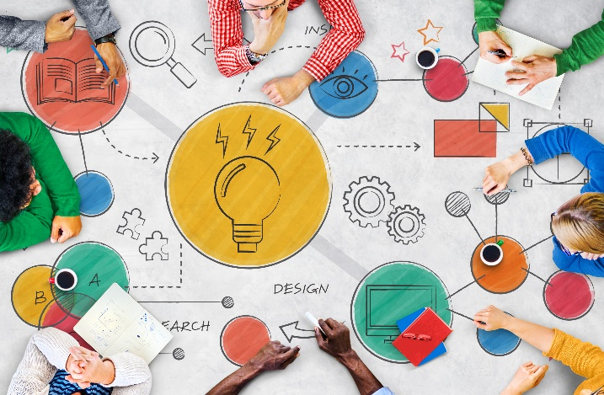
Strategic Benefits
Enhanced Decision-Making: Easy access to performance data enables staff to make evidence-based decisions for more effective service delivery.
Strengthening Collaboration: Cross-team visibility encourages collaboration and reduces silos.
Enhanced Staff Experience: Time spent searching for data is reduced, enabling higher-impact work
Improved Performance Visibility: Increased visibility helps identify successes and areas needing improvement for strategic growth.

Slide 5
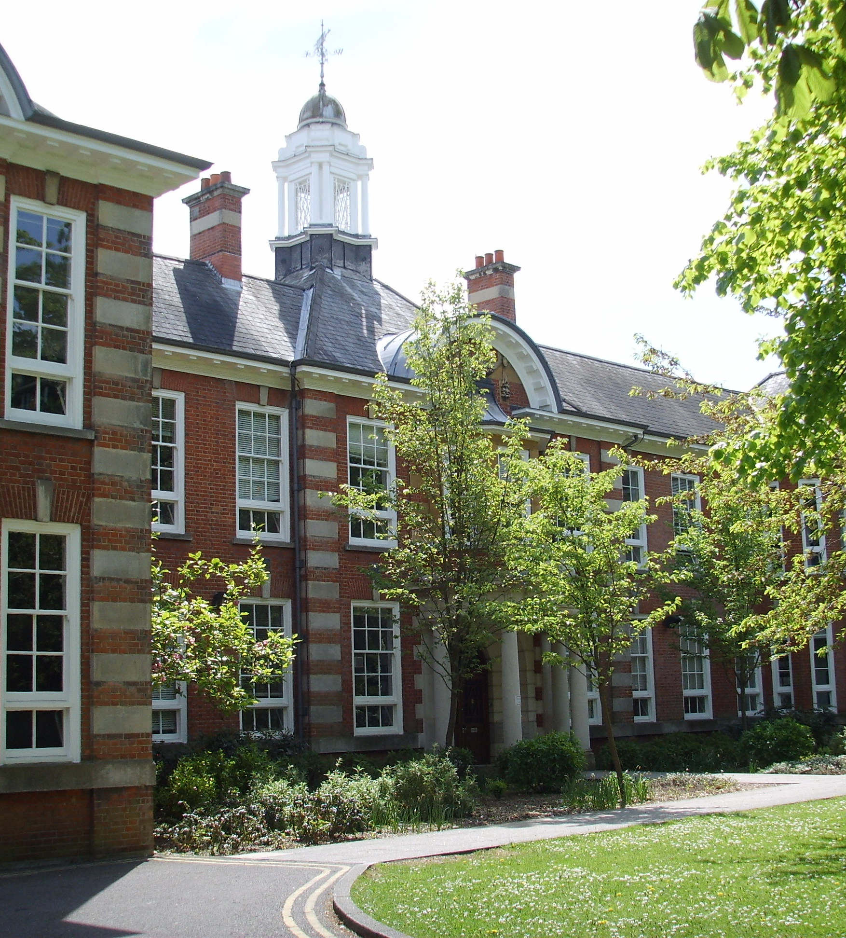
How We’re Delivering The Project
Collaborative and Strategic Foundations
Defined project scope and deliverables through consultation with Library staff and critical friends, ensuring shared vision and meaningful engagement
Sector Benchmarking
Engaged with 7 peer institutions to learn from their data practices, shaping our approach and avoiding common pitfalls

Slide 6
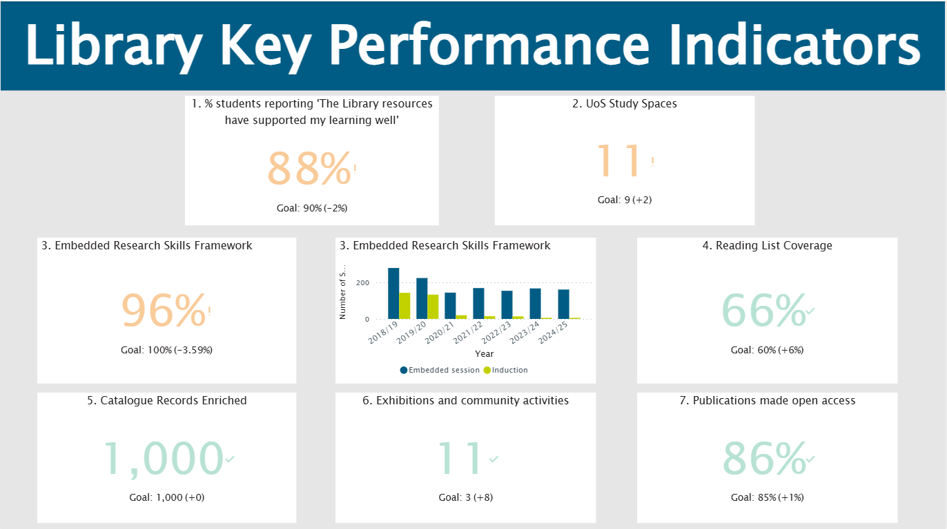

Slide 7
How We’re Delivering The Project (2)
Impactful First Deliverable
Developed a central Power BI dashboard for Library KPIs, integrating scattered data sources and embedding it into internal governance.
Superuser Model & Culture Building
Empowered data enthusiasts across teams to champion the project, fostering a growing community and embedding a data-driven culture.

Slide 8
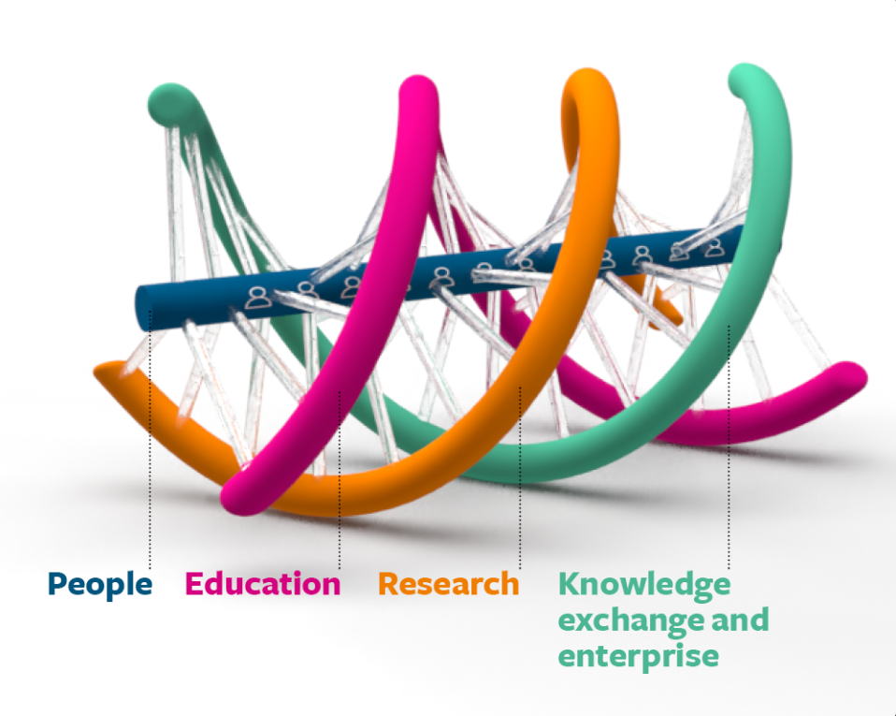
Aligning With The University Strategy
University Digital Strategy
  Aims to embed digital tools and data into how we work and make decisions, to enhance both the student and staff experience.
  Triple Helix Strategy
  Focuses on integrating and strengthening the relationship between Education, Research, and Knowledge Exchange & Enterprise.
  Seamless Digital Services
  Utilising automation, AI and better management of our data to improve the interconnectivity of services across the Triple Helix, increasing the efficiency of our operations and improving decision making.
  Demonstrates Contribution
  Dashboards provide an evidence-based way to showcase the Library’s contribution to the wider University strategy and highlight the Library’s value in enhancing the student experience.

Slide 9
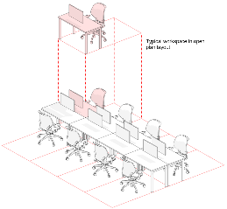
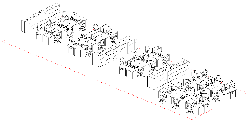
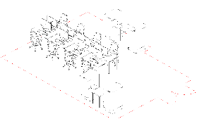
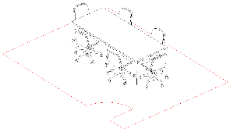
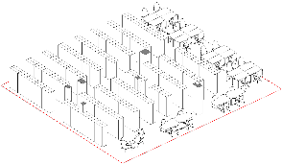
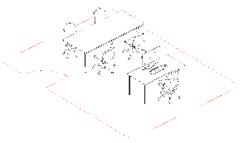
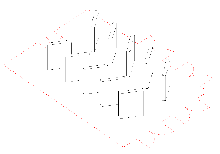
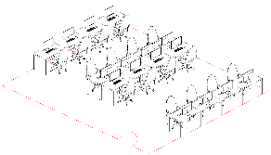
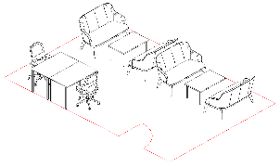
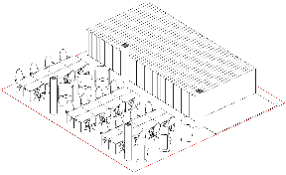
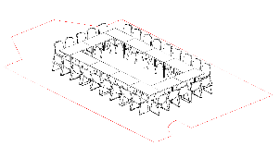
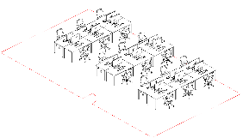
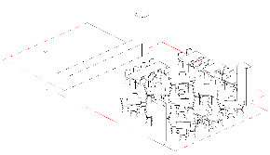
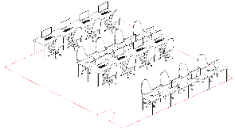
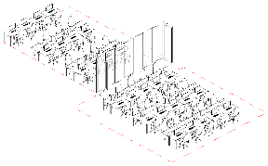
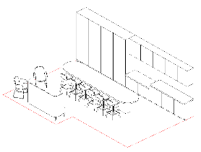
Informing Institutional Decision-Making
Hartley Library Transformation Project
Target 20% ‘group’ study,
80% ‘individual’ study
1-3P workspaces
1x 1P Room
2.1m² pp
80 desks
furniture suitably spaced to allow inclusive access
Engage & Innov Team
Customer Points – 8 no.
Open Study Spaces
existing library:
1919 study seats
User Experience
Training Tables
Shared Offices
Tech & Systems
Tech Hub
Informal Seating
11 x 1P
5 x 4P
Workshop Desks (2 no)
23 x 6P
17’000 lin m
Library Services
Near Entrance
Workshop Stores
Closed Study Rooms
2 x 8P
wider aisles
Digital Scholarship
Before Secure Line
Laptop / AV Lockers
1 x 10P
Shelving
Designated Offices
Collections Team
Exhibition
Near Entrance
IT
+581 Spaces
Book collections
14%
Staff & Ops
750m²
Creative
640m²
487m²
Study Spaces
17,200 lm
of Shelving
retained
More Efficient
More
Space
Partner Services
More
Space
30%
Family-Friendly Room
1 x Large 18P Room
Digital Collaboration
Vending
4 x 1-on-1
62% of the total linear meterage
1 x Hybrid 10P Room
Staff Workspace
Student Kitchen
Compact Shelving
Meeting Rooms
1 x 4P Room
Digital Scholarship
Eating / Social
Specialist
Digital Scholarship Lab
Catering
Café Servery
Assistive Technology
50P Seminar Room
Kitchenette
Flexible Study
Eating Area
Training
Breakout

Slide 10
Informing Institutional Decision-Making
Enquiry Transformation Project
Project aims:
Streamline Library Enquiry Processes
  Aims to integrate all library teams into one enquiry management system with consistent enquiry handling processes and customer expectations.
  Reduce Customer Contact Points
  Review and condense the number of external facing email addresses, customer contact forms and surveys to make accessing services simpler for the customer.
  Improve Feedback Collection
  Collate feedback from customers in one central place which will make it easier to understand what customers are saying about the Library Service.
  Performance Tracking
  Utilising one central enquiry management system for all library teams will allow for effective data collection against Library Key Performance Indicators from one singular source.

Slide 11
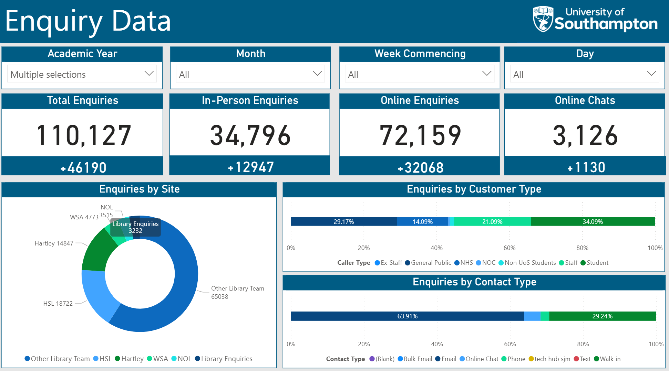
Informing Institutional Decision-Making
Enquiry Transformation Project

Slide 12
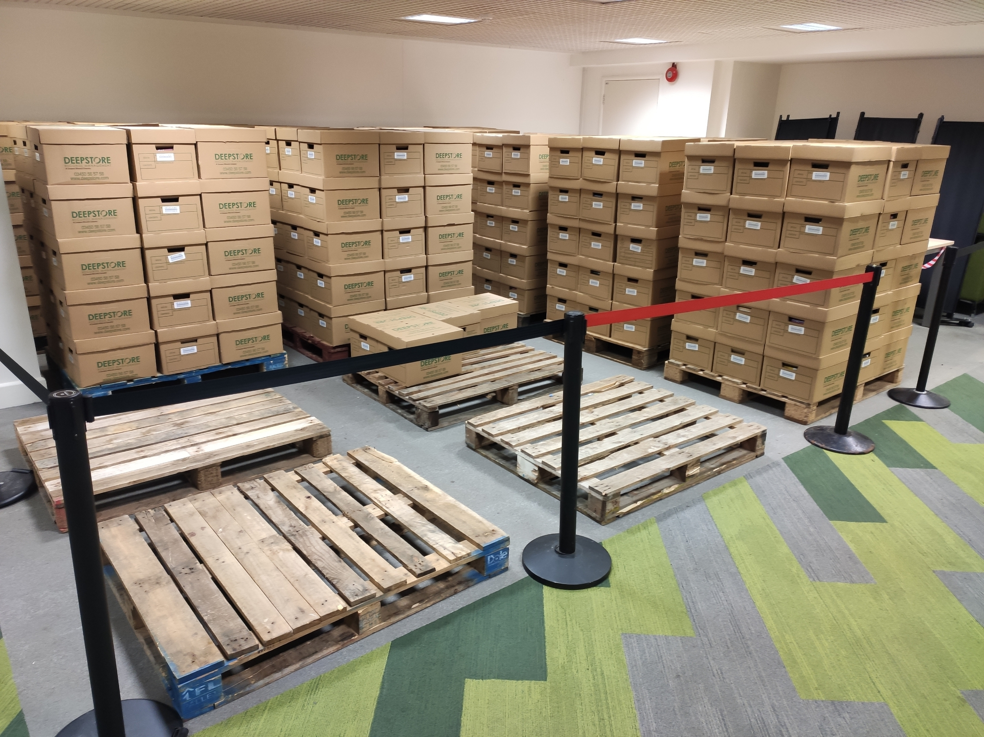
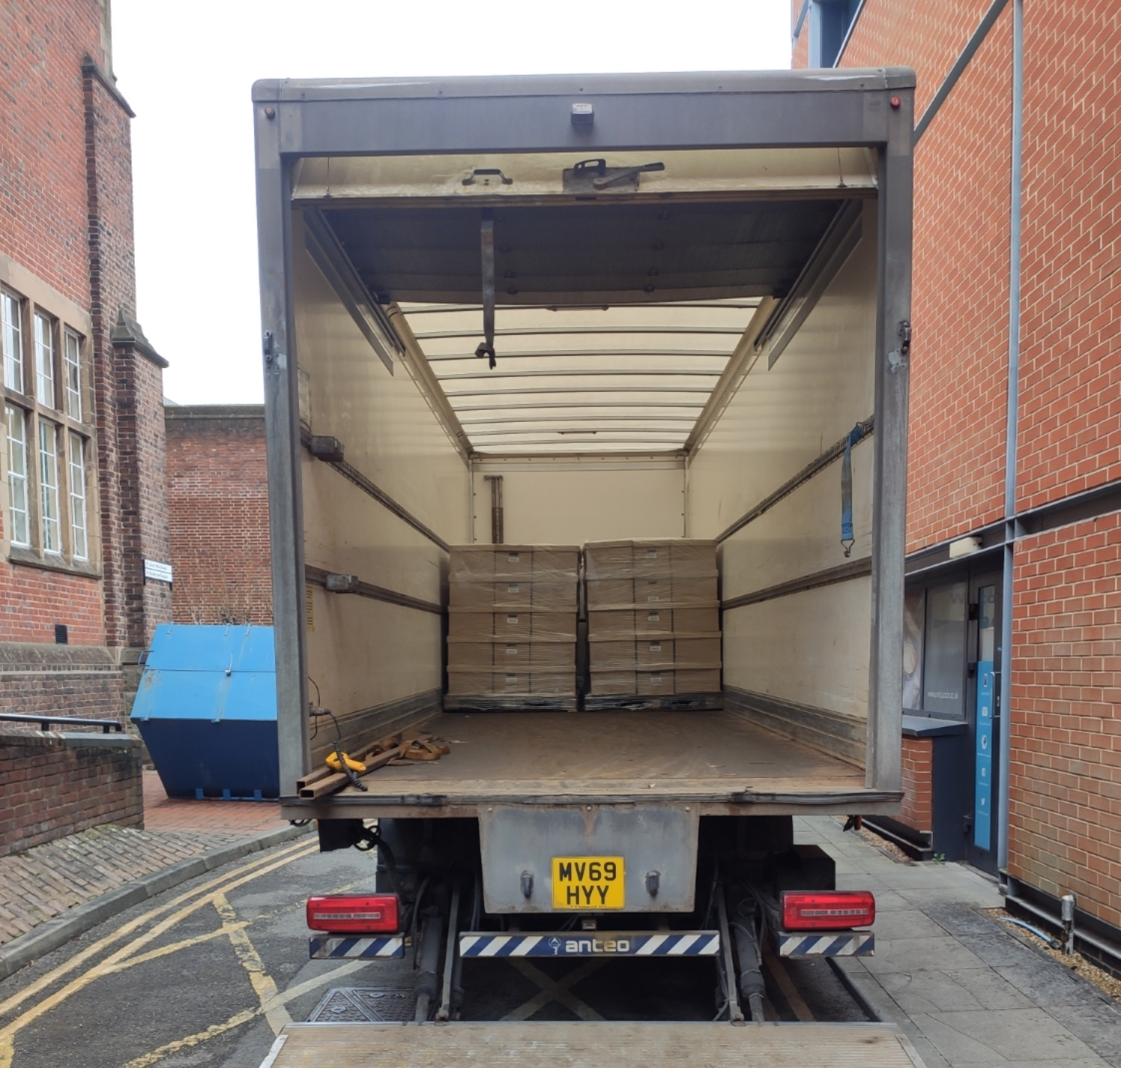
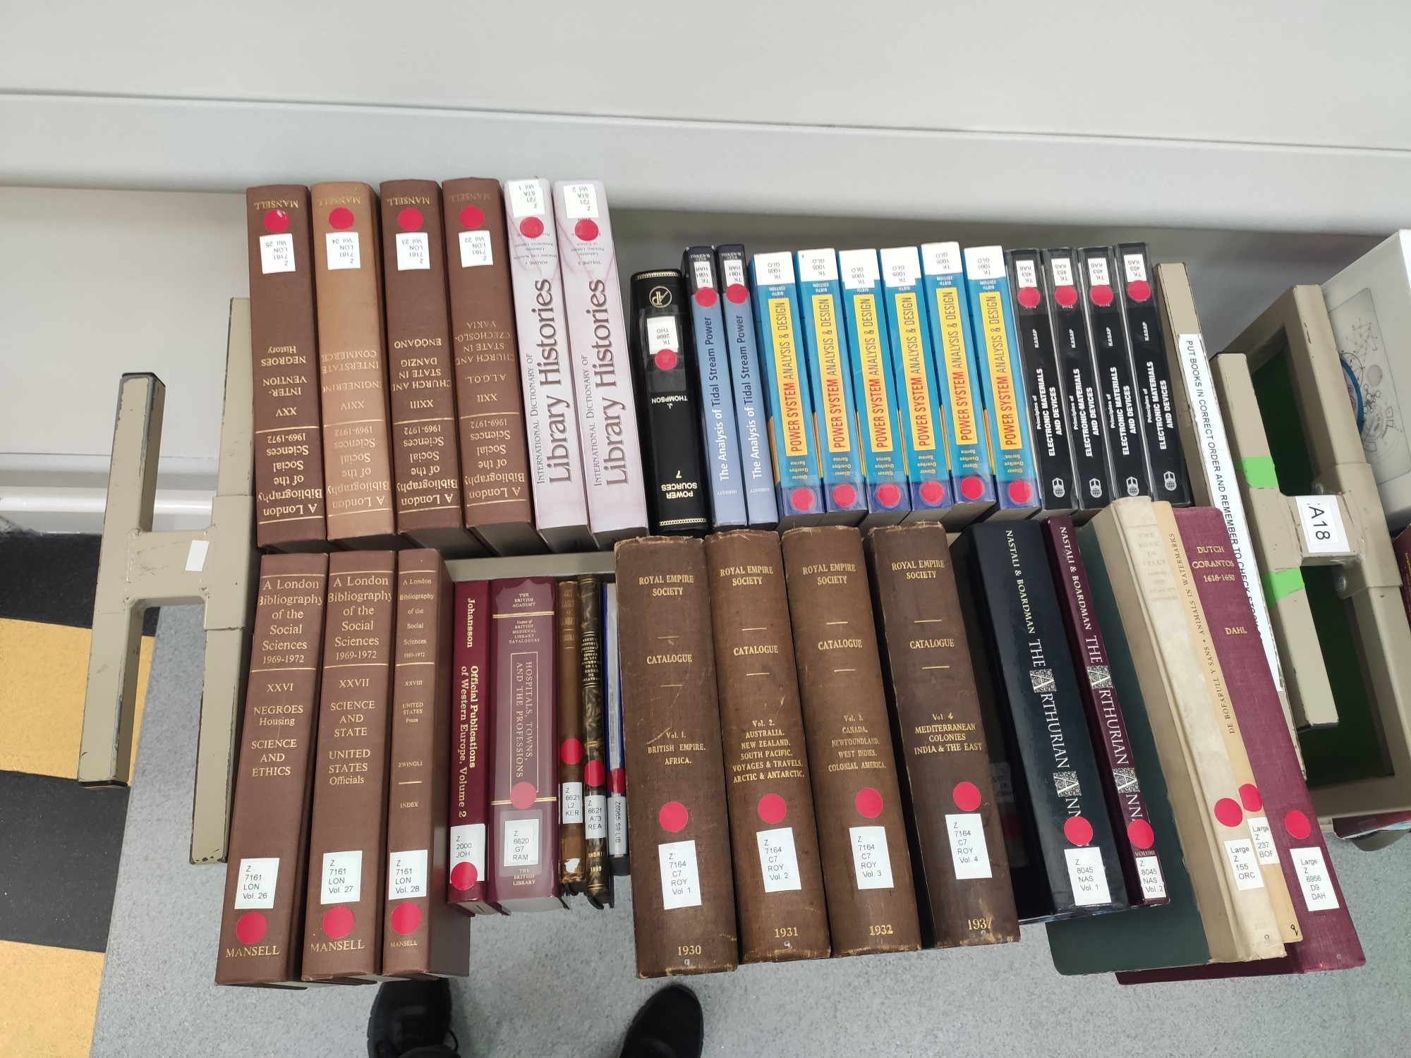
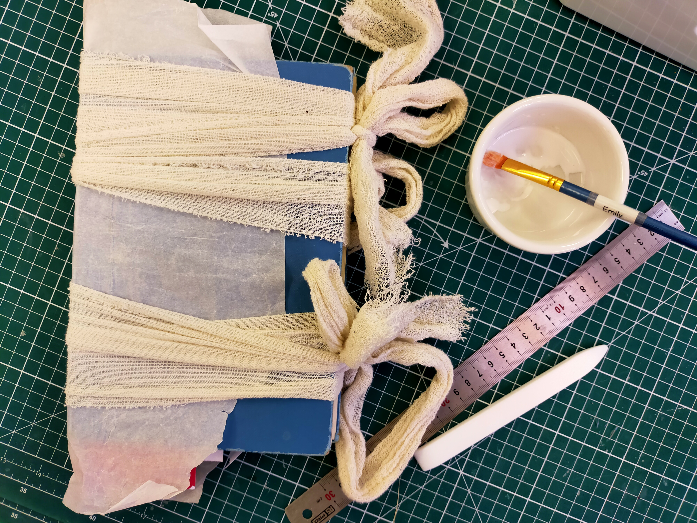
Informing Institutional Decision-Making
Collections Development and Discovery Project
189,300+ items sent to storage
63,000 items deaccessioned from collection
16,120 records confirmed as missing/non-existent
Improvements made to over 11,000 metadata records
Over 91,000 items reclassified
87,300 items repaired or cleaned
Academic consultation on all 532,000+ items in scope
Over 10,000 lines of feedback received

Slide 13
Local Impact: Customer Satisfaction
KPI Set
KPI given on customer satisfaction in enquiry handling
Target 90%
Data Gap
Existing data sets explored
Gap in data identified
CSAT form launched
Shared with library through Power Bi
Data Shared
Move to proactively requesting feedback
Data Collected
First quarter of data has now been captured
Form sent after every online enquiry

Slide 14
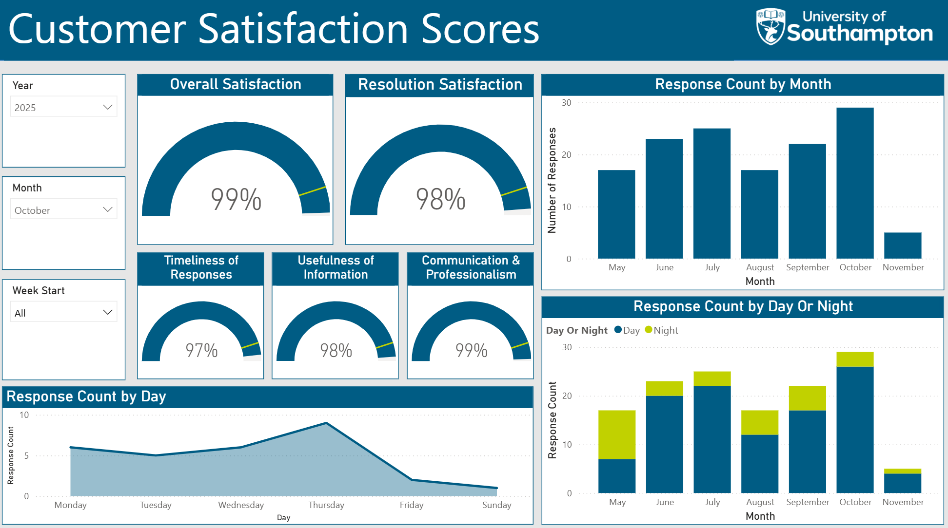

Slide 15
What’s Next?
Dashboard Expansion
Continue refining and expanding Power BI dashboards with new datasets and improved visualisations to enhance usability across the Library
Growing the Superuser Network
Recruit and support more data enthusiasts to champion data practices and build momentum across teams.
Embedding Data Confidence
Focus on developing data skills across all staff, ensuring everyone can use dashboards and make evidence-based decisions.
Building a Lasting Culture
Aim to make data an everyday part of Library thinking — fostering a legacy of insight, empowerment, and innovation.

Slide 16


