Slide 1
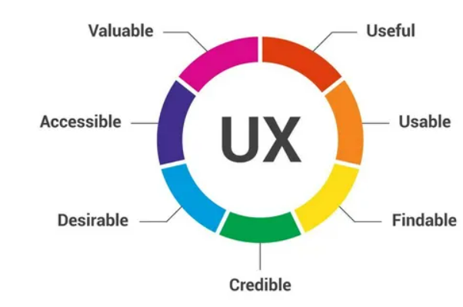
INSIGHTS TO ACTION UX Testing ChatBot Services
The Open University
Library Services
Manda Laine and Lizzie McCauley
The OU Library
Friday 28/11/2025

Slide 2
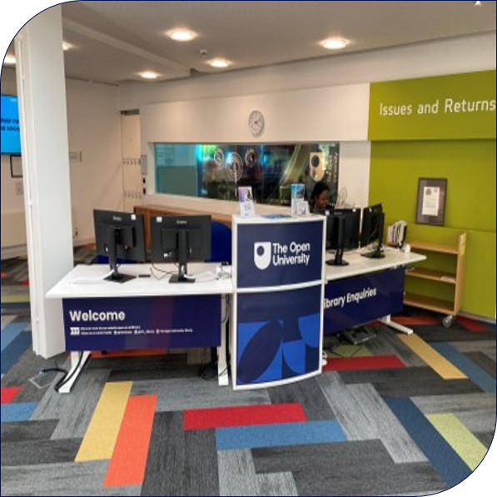
Enquiry Services at the Open University library
Library helpdesk
Front of House
Team – (Enquiries Manager, 13 librarians, 11 Library Assistants)
Library building
Webchat (24/7)
Phone
Email
Find us at https://university.open.ac.uk/library/
Notes:
The Enquiry Service is one team in the Student and Academic services division of Library Services. We have a mixture of full time and part time staff and with the exception of our Enquiries manager, all staff who work on the helpdesk, have other responsibilities alongside their enquiries work. Whilst we are a distance learning institution, we do have a large library building on the Walton Hall campus in Milton Keynes which is open to staff, students and the general public. As a result, we do have a face-to-face presence in the library and answer enquiries that way too.
We answer most of our enquiries remotely as you might expect and this is done via email, phone and webchat. Monday to Friday 9-5, OU library staff answer webchats, outside this time we are part of the Springshare co operative which answers webchats for us when the OU Library is closed. Email and webchat are our busiest channels. I’ll give you an example of our numbers on my next slide.

Slide 3
October 2025 Statistics
432 webchats in opening hours plus 257 out of hours
673 emails received
278 Face to face enquiries
122 phone calls

Slide 4
What prompted our pilot?
8,675 webchats answered in 2023
1,902 of these included a link to a library webpage
216 of these transactions were simple and could be answered quickly by a chatbot
A further 595 could be answered by a chatbot given the right response
Approximately 9% of our webchat enquiries could be handled by a chatbot.
Estimated time saving of 34 hours per annum
Notes:
In 2023, the Library Helpdesk and our 24/7 Cooperative answered 8,675 webchats. 1,902 of these transcripts included a link to a library webpage. We identified that 216 of these transactions were simple and could be answered quickly by a chatbot. A further 595 could be answered by a chatbot given the right response. Therefore, approximately 9% of our webchat enquiries could be handled by a chatbot.
Approximately half of all webchats are answered during our working hours. So, if 4.5% could be handled by a chatbot, and taking an average handling time of 5 minutes per chat, this amounts to an estimated time saving of 34 hours per annum.

Slide 5
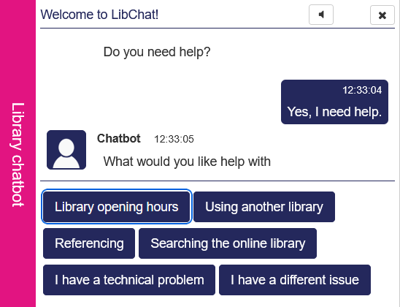
Designing the workflows
Student enquiries and website traffic
The chosen Chatbot was appropriate for our budget and was easily configurable. However, it did not use natural language chat, it was not AI driven, but rather uses workflows
These workflows had to be decided and built in the system before the Chatbot could be launched
Using a year's worth of data from existing webchat services, we ascertained the most popular categories of enquiry
This was compared with the most popular pages on the Library website, using Google Analytics, to see what users were already engaging with
The combination of these insights allowed us to build workflows that addressed these queries and topics
Notes:
The Library website gets 100s of thousands of visits per month

Slide 6
Usability testing – Chatbot on Library Search
To gain feedback from users about the usefulness and effectiveness. Usability testing helps us identify when and where users succeed and fail, it helps us to gain a better understanding of users' behaviours and goals.
By conducting usability testing, we can evaluate the following qualities:
Effectiveness: enables the user to easily accomplish the task
Efficiency: enables the user to accomplish a task quickly, with a minimum number of steps
Attractiveness: the user interface is visually appealing
Learnability: easy to learn how to use
Memorability: easy to remember how to use
Notes:
To gain feedback from users about the usefulness and effectiveness, usability testing helps us understand how users interact with our product. It shows us where they succeed and where they struggle. By testing, we can evaluate how effective, efficient, attractive, easy to learn, and easy to remember our product is. This feedback helps us improve and meet users' needs better.

Slide 7
Participant turnout – November 2024
Library Search (Primo VE)
Users: OU staff, OU student, postgraduate researchers (PGRs).
Usability testing was conducted between Mon 25/11/2024 – Fri 29/11/2024
The original number of people invited to participate: 7 members of staff, 6 PGRs and 12 students.
When we reached our quota of 5 in each user group, we cancelled remaining sessions. Users were informed that this may happen. Unfortunately, we had 3 students cancel at short notice and 5 student no-shows. This remains the trickiest user group to recruit for, despite offering financial incentives.
The actual number of participants from each user group who engaged: 5 members of staff, 5 PGRs and 4 students. 14 participants in total!
Notes:
In November 2024, we conducted usability testing with OU staff, students, and postgraduate researchers (PGRs).
We initially invited 7 staff members, 6 PGRs, and 12 students. Once we reached our quota of 5 participants per group, we cancelled the remaining sessions and informed users in advance that this might happen.
Unfortunately, 3 students cancelled at short notice and 5 did not show up, making students the hardest group to recruit despite financial incentives. In the end, we had 5 staff members, 5 PGRs, and 4 students participate, in total 14 participants.

Slide 8
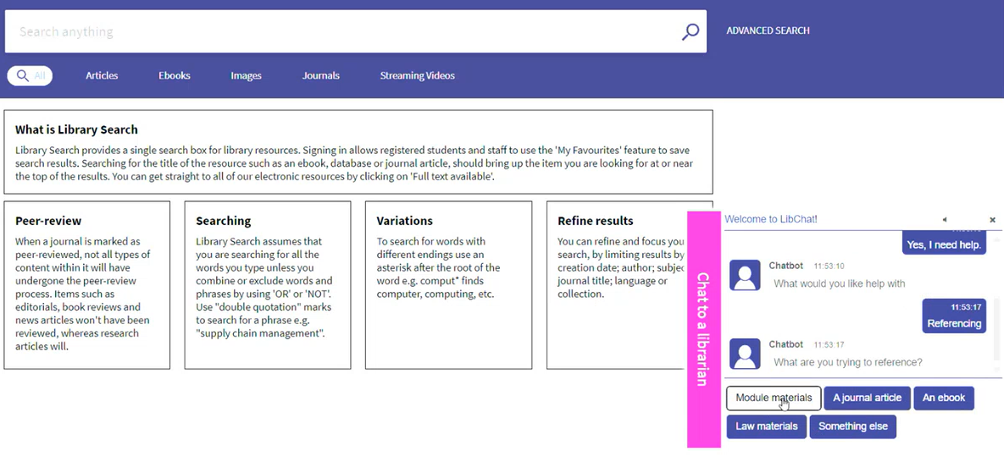
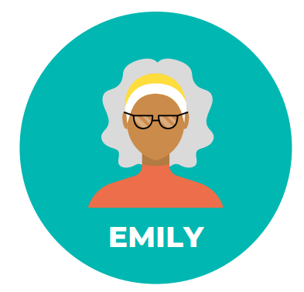
Results and recommendations
11 out of 14 participants did not use the Chatbot for help.
8 out of 14 participants didn’t notice the Chatbot. In some instances, the chatbot presented technical issues, making it unusable
10 out of 14 participants said the visibility needed improvement after being prompted.
Only one person liked their experience with the chatbot.
6 out of 14 participants asked, “what happens if the chatbot does not have their question as a choice?”
"not very clear how to ask what I want or how to ask a question that's not a preset question."
Notes:
These findings suggest that the Chatbot is not effective in its current form. An option for the future is that we could reconsider the workflows in Library Search to be more tailored.

Slide 9
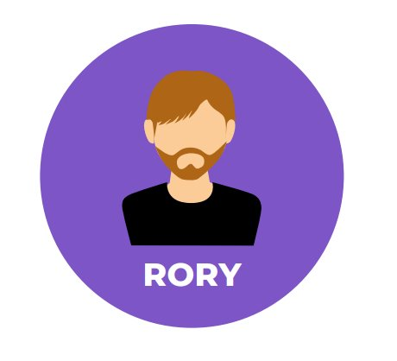
Data analysis – Chatbot on the Library website
Student enquiries and feedback
The Chatbot includes a feedback feature, for users to comment on their experience using it
25% of comments were negative feedback
  "completely useless waste of time"
  "This has really NOT been helpful at all"
26% of comments were positive feedback
  "Chat box is very good and quick!"
  "Seems precise and easy to use, good impression on my end"
49% of comments were enquiries, which was almost more of a concern
At this point, there was no option for users to bypass the Chatbot
We added this option to capture those users that were getting stuck
"Desperately want to talk to real librarian but keep getting stuck in chatbot loop - HELP!"

Slide 10
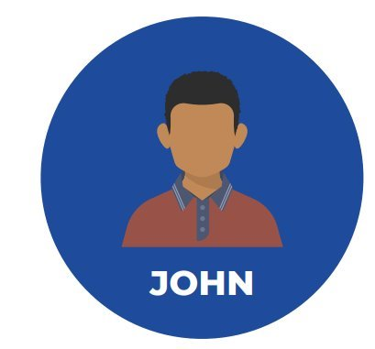
Survey – Chatbot on the Library website
Hosted a survey on our Library website for 3 months and got 154 responses. 84% (130) were students
44% hadn't noticed the Chatbot
68% had no strong opinion on how helpful the Chatbot was
66% had never or would never use it
71% had no preference over where the Chatbot should be positioned
"I loathe chatbots and avoid them whenever possible. I recognise that this technology frees up human librarians to respond to more complex queries, but I would always prefer to talk to an actual human, and not a machine acting like one."

Slide 11
Coming up – review of categories
Survey data to improve workflows
Current workflow categories
Library opening hours
Using another Library (SCONUL)
Referencing
Searching the online library
I have a technical problem
Popular categories from survey
Finding specific books, journals, or databases (57%)
Help with referencing and citations (e.g., Harvard, APA)( 41%)
Common technical issues (e.g., logging in, accessing resources etc)(39%)
Help with research strategies or finding credible sources (36%)
Study skills and research guidance (29%)
Information about specific library workshops or events (26%)
Information about library opening hours or contact details (21%)
Borrowing or returning items (19%)
SCONUL (16%)

Slide 12
Thank you

