Slide 1

Insight into Action: How Data Informs Decisions at Queen’s University Belfast Dr Robert Whan (Customer Experience Manager)
Dr Robert Whan (Customer Experience Manager)

Slide 2

The McClay Library

Slide 3
Data Collection Toolkit
Feedback
Compliments/
Complaints
Evaluations
Gate counter
Alma (LMS) analytics
Surveys
Benchmarking
Reverse mentoring
Sentiment analysis
Mystery visitors
Monthly Tea with PVC
Website & social media analytics

Slide 4
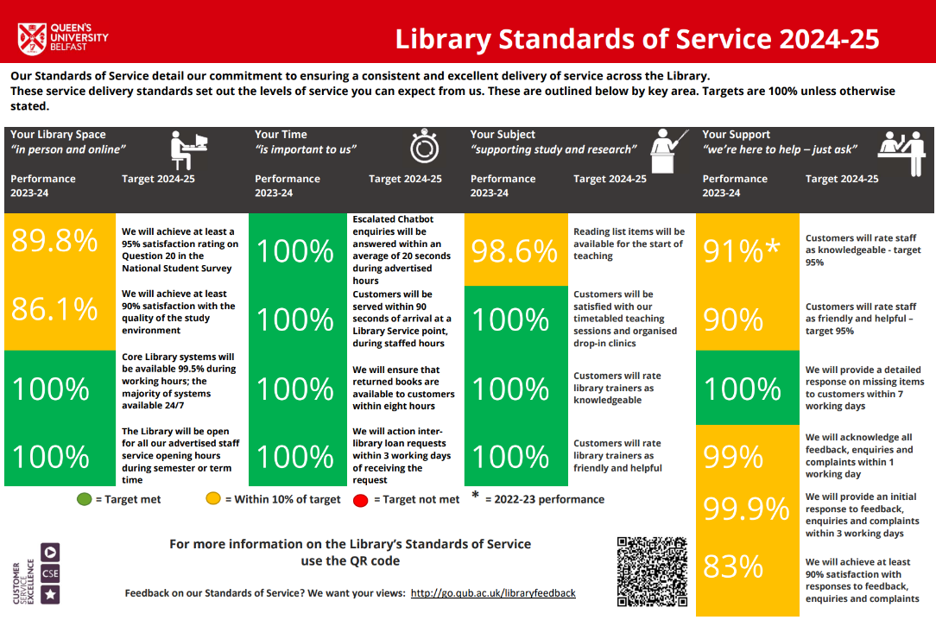

Slide 5
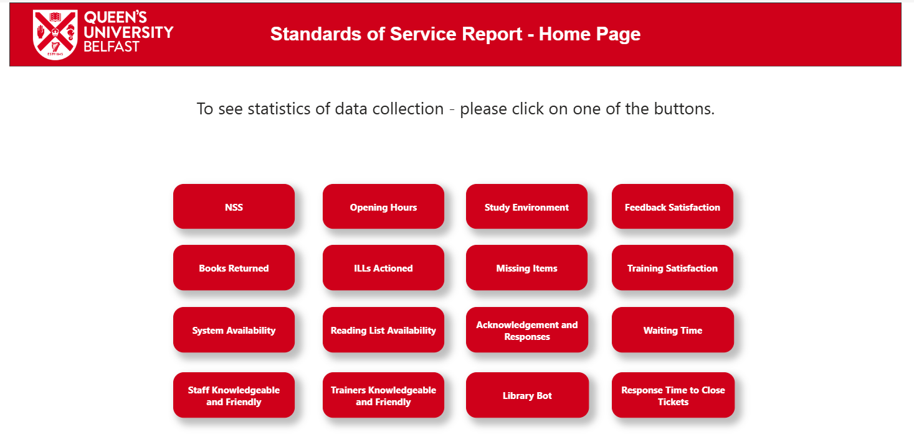

Slide 6
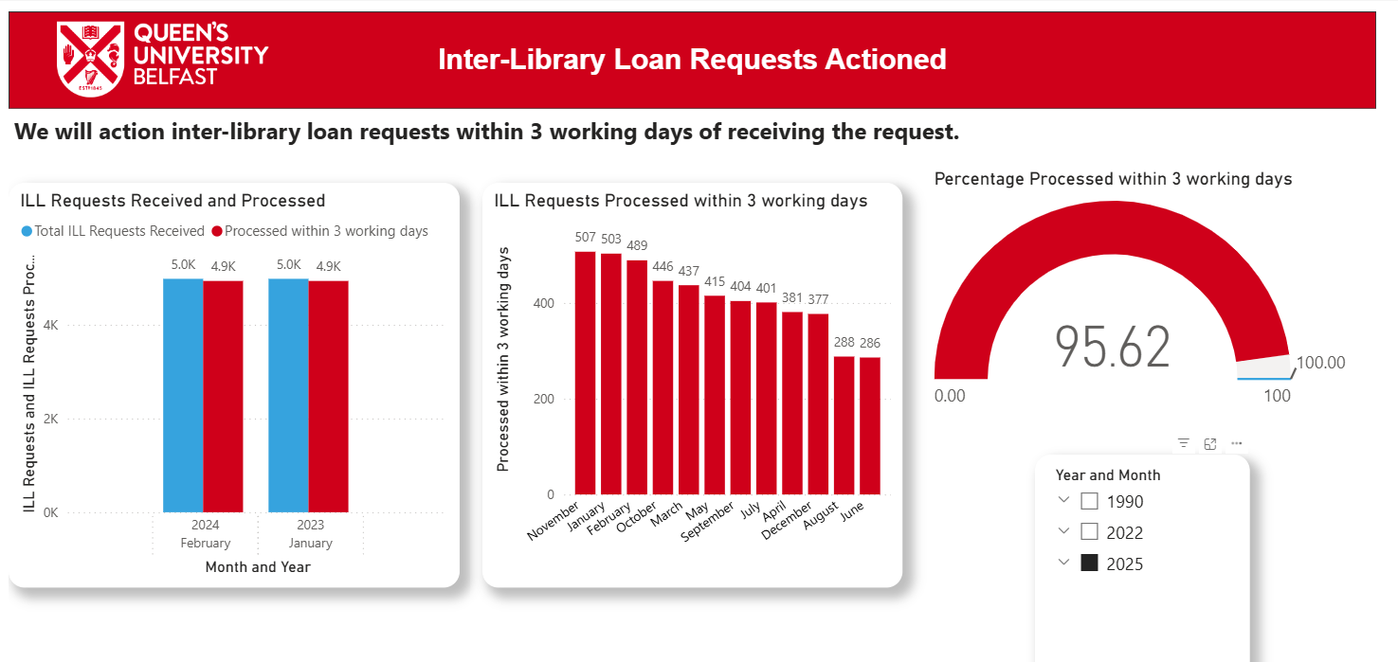

Slide 7
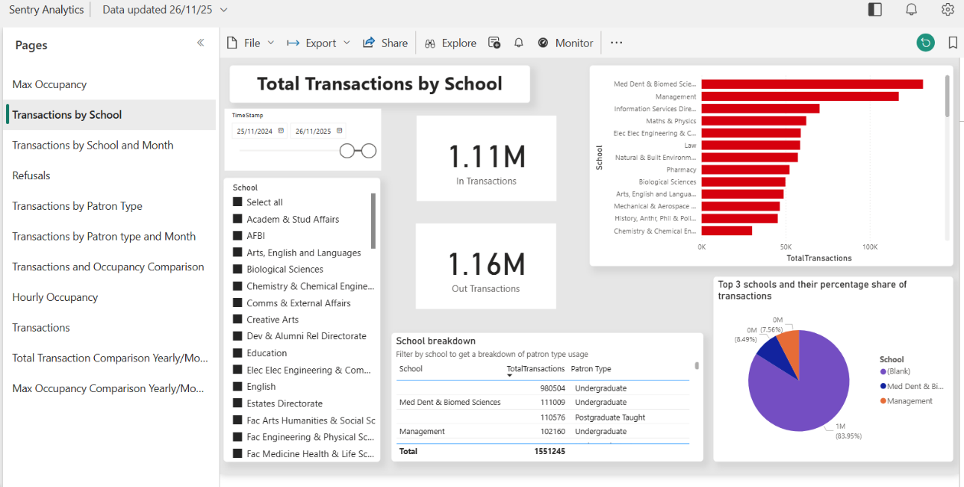

Slide 8
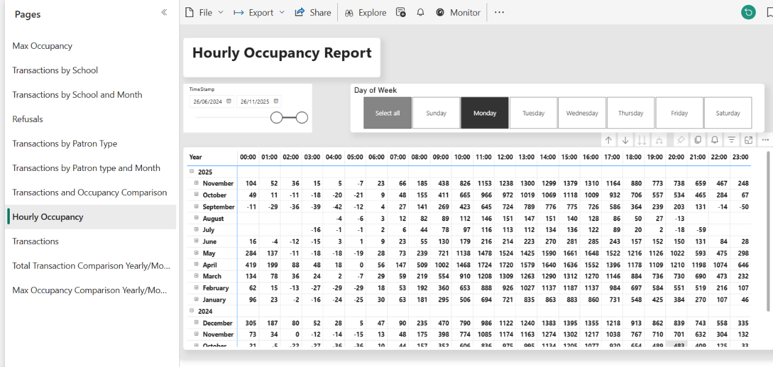

Slide 9
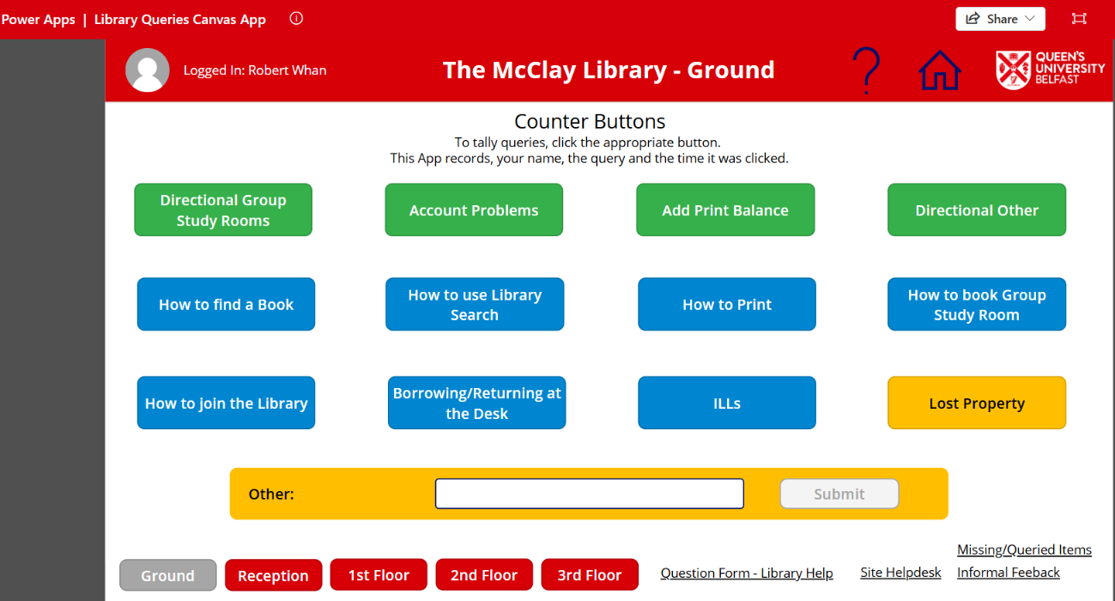

Slide 10
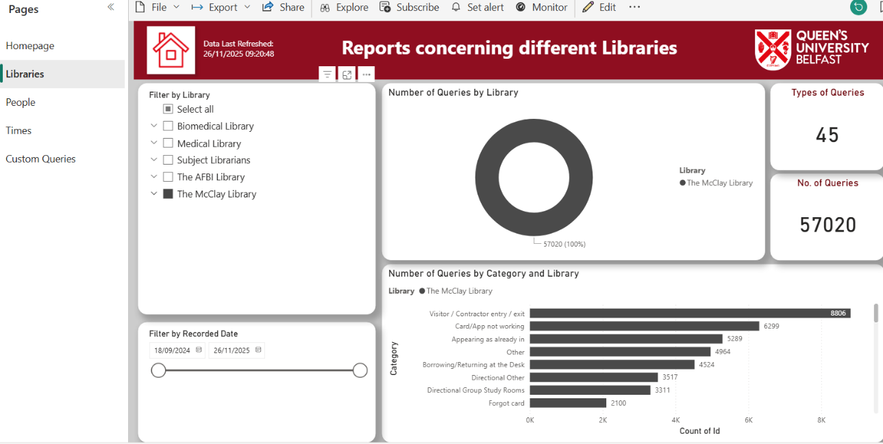

Slide 11
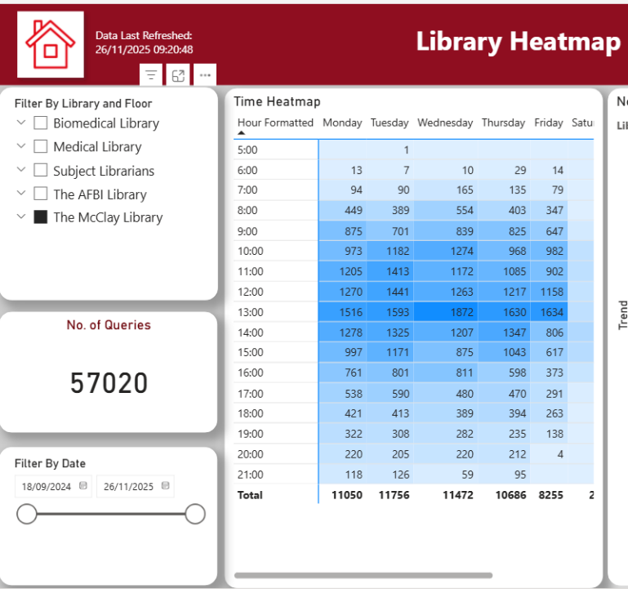

Slide 12
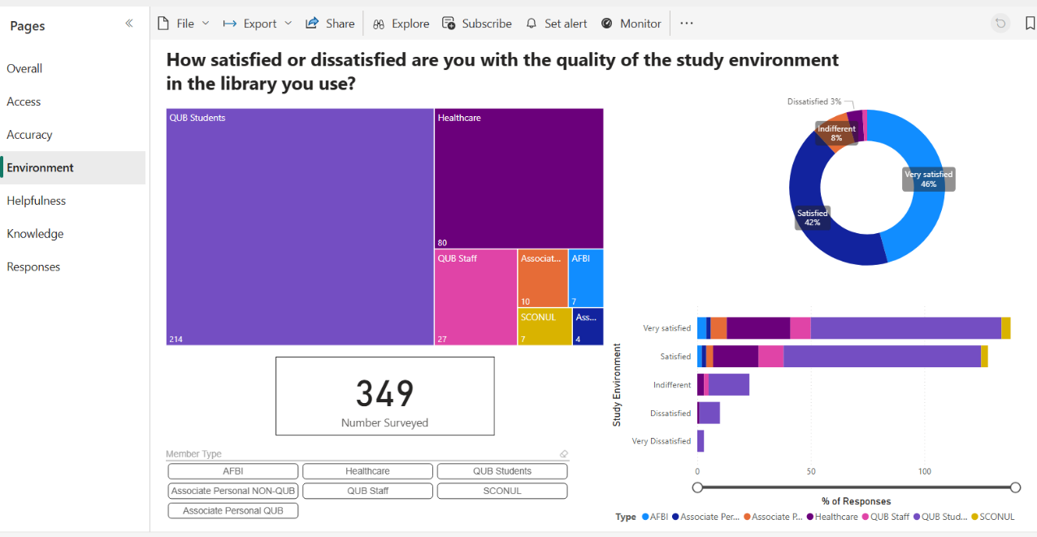

Slide 13

The CX (Customer eXperience) Process

Slide 14
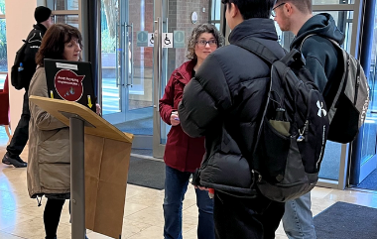
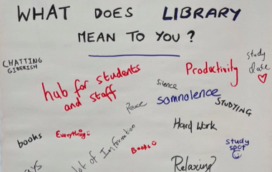
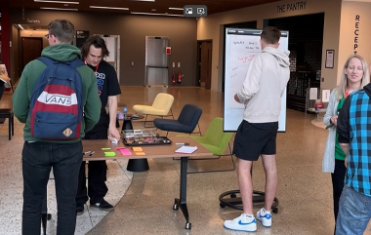
Embedding CX Techniques
Graffiti walls
Interviews
Photo studies
Cognitive mapping
Love & break-up letters
Observation
Behavioural mapping
Customer-led tours
Usability testing

Slide 15
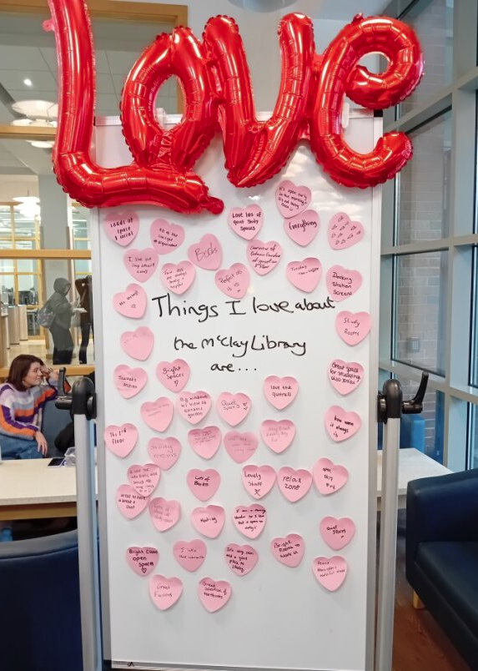
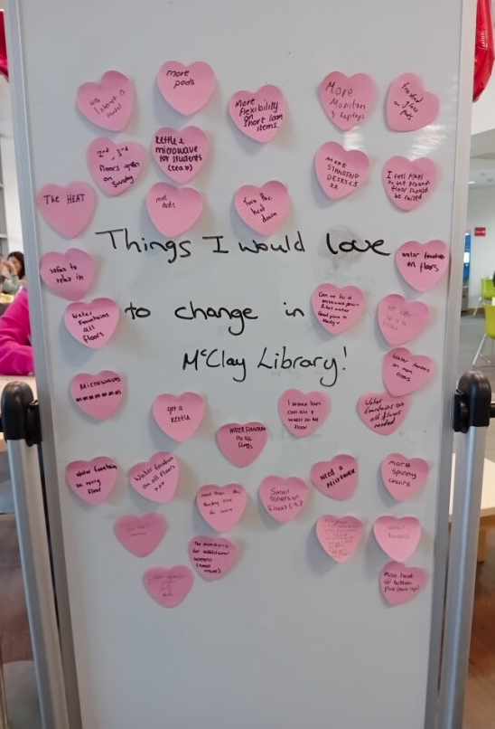

Slide 16
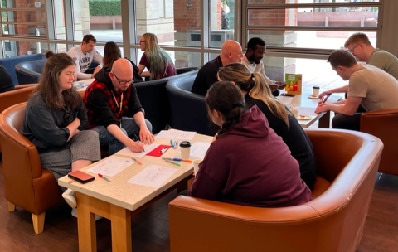
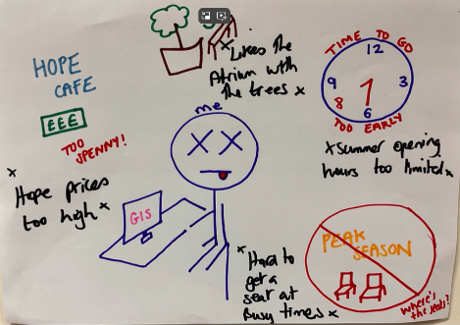
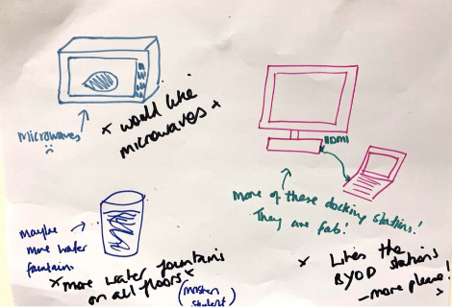
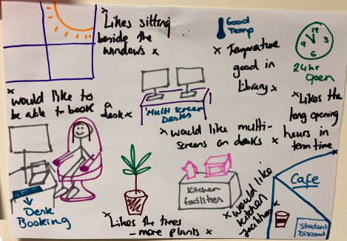
Cognitive Mapping

Slide 17
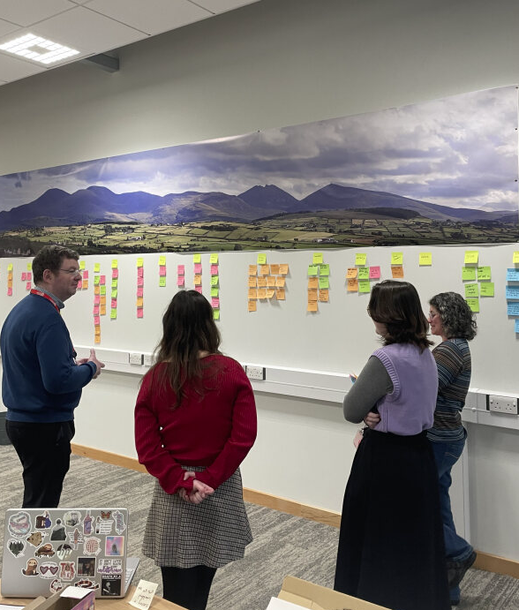

Affinity Mapping & Idea Generation

Slide 18
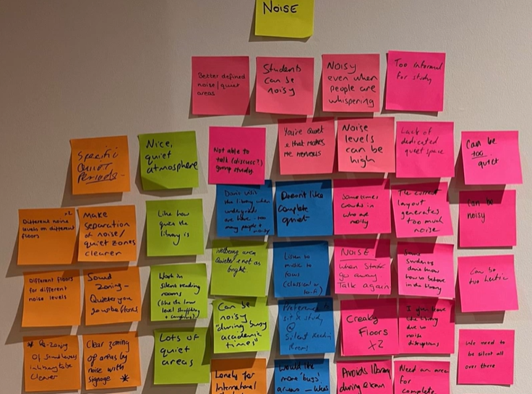

Slide 19
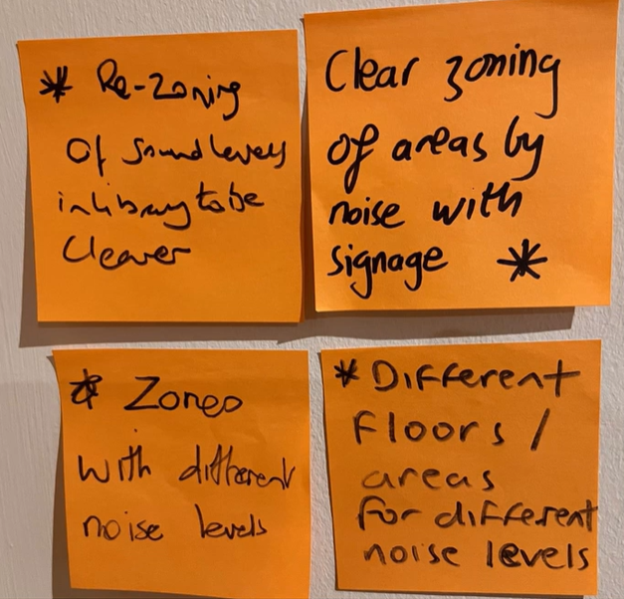
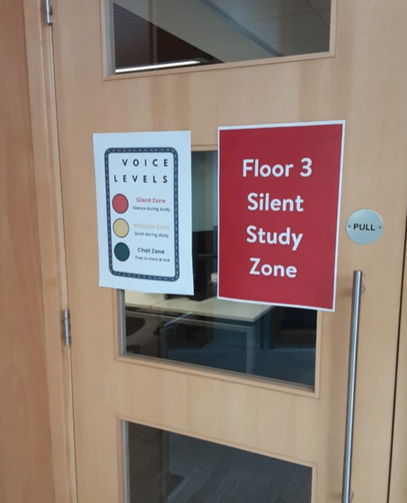
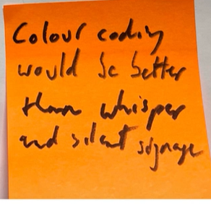

Slide 20
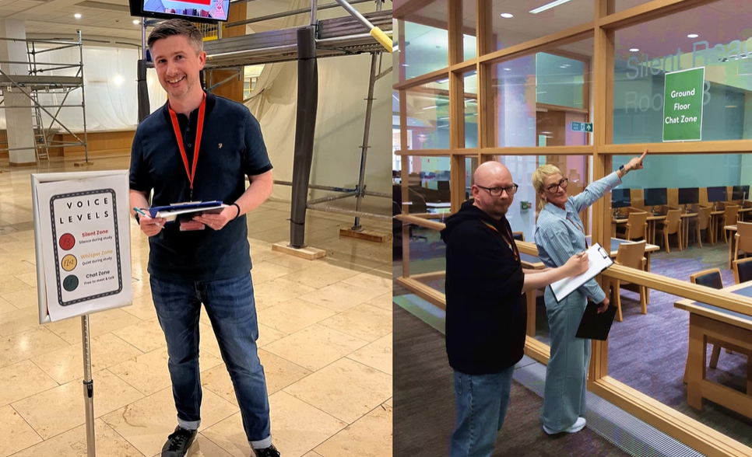

Slide 21
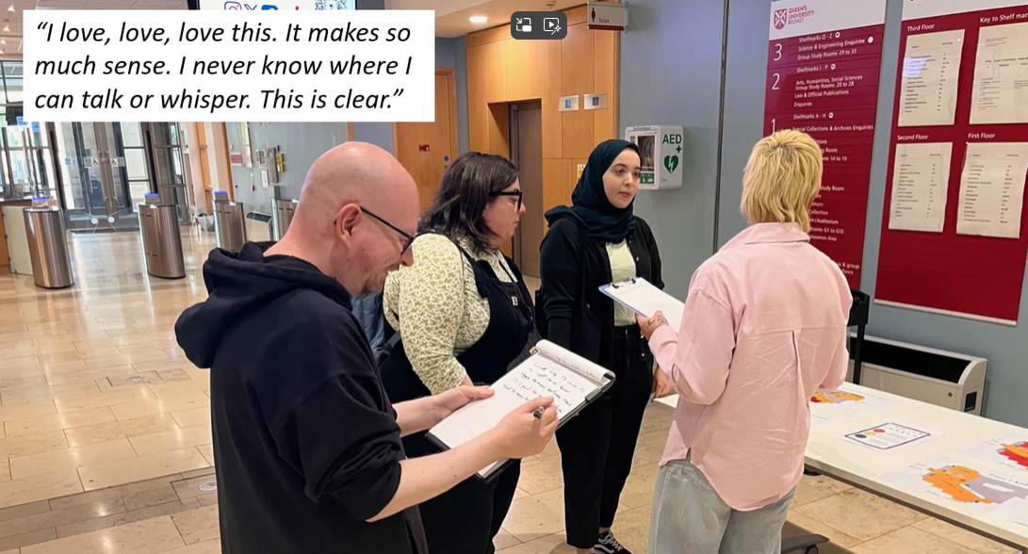

Slide 22
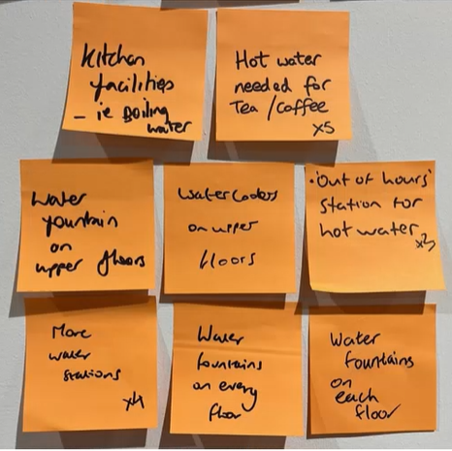

Slide 23
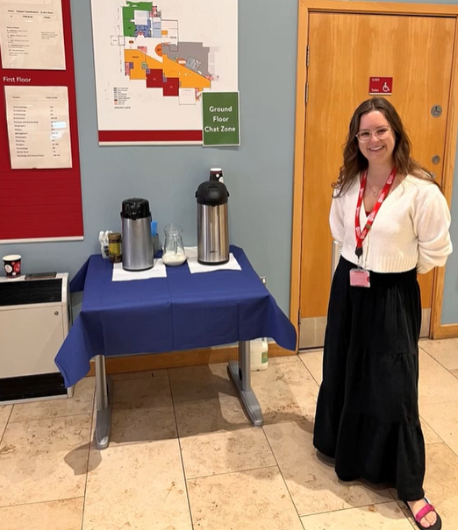
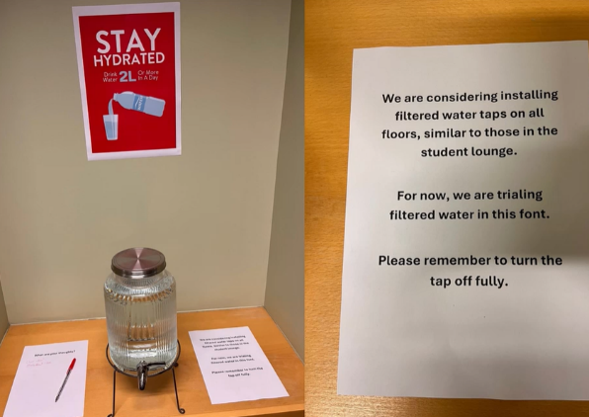
Prototyping

Slide 24
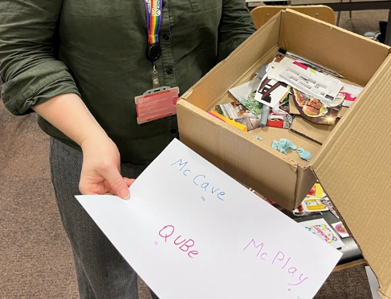
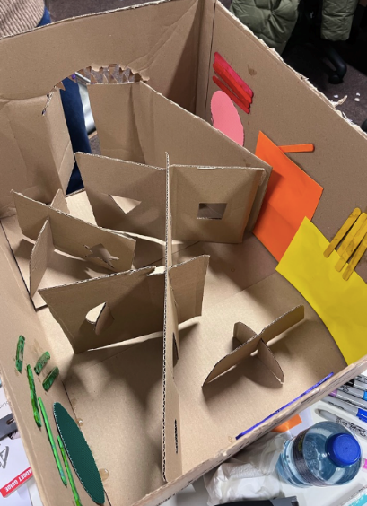

Slide 25
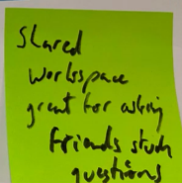
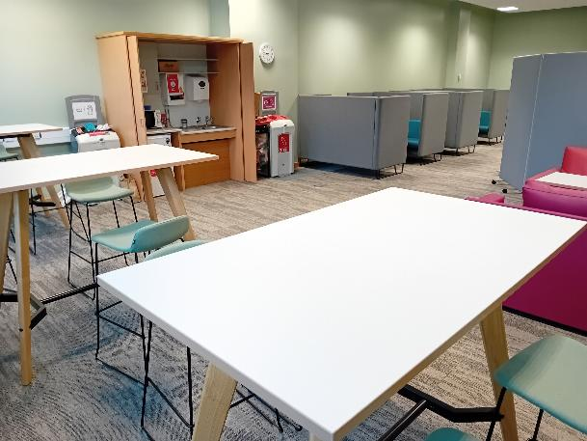
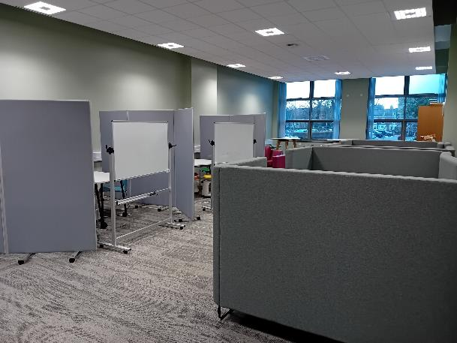
Introduction of Co-Lab Space (September 2025)

Slide 26
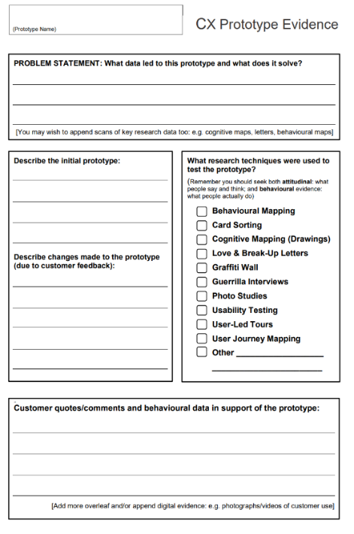
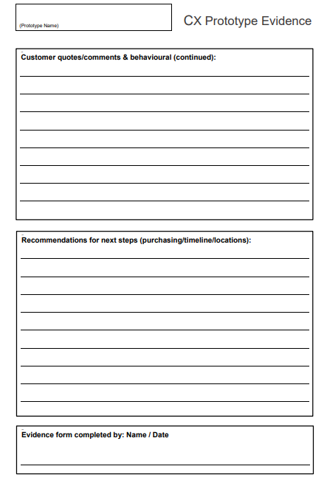

Slide 27
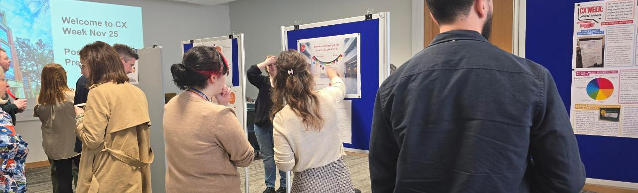
Changing Culture
Gathering evidence
Not assuming what customers want and feel
Empowered to test and try new things
Co-ordinated and communicated

Slide 28
Insight into Action: How Data Informs Decisions at Queen’s University Belfast Dr Robert Whan (Customer Experience Manager)
Dr Robert Whan (Customer Experience Manager)

